Slide 1
‘semantle’ AI challenge
Software engineering final project

Slide 2



MEET OUR TEAM
Nes Afriat
Yuval Hitter
Bar Damri
Presentation & Programmer
Algorithms, Programmer
Coordinator & Programmer

Slide 3
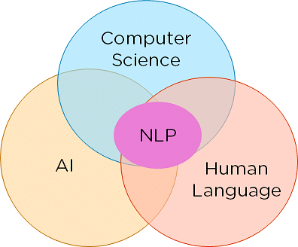

The problem domain
Our research relates to the field of AI and NLP, where various efforts are made to develop advanced technologies that can solve various problems effectively and autonomically.
We decided to challenge ourselves with a computer game related to the NLP field and fun to play.
The main goal aside from creating an AI
Algorithm that defeats it, is using the experience
And knowledge we gain during the process, for supporting academic research.

Slide 4
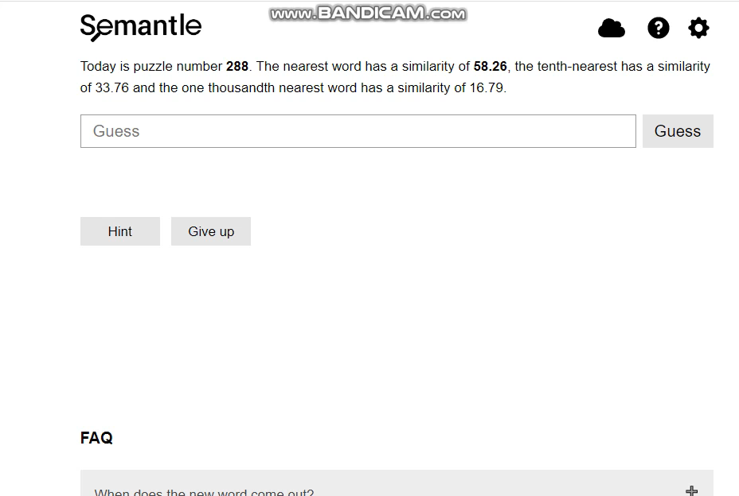
Semantle -
‘Semantle’ is a popular online words’ game.
1. The player guess in each turn the host secret random word.
2. As reply - he gets the semantic similarity score from the host.
3. The player can also get a ‘hint’ – a word which relatively close to the secret one.
And it’s a tough game!!

Slide 5



The challenge
We want our program to defeat the game ‘Semantle’ by itself – in the minimum guesses possible!
But how?

Slide 6
Our solution – and field of research
Word Embedding
AI
one of the most popular representation of document vocabulary as vectors.
Artificial intelligence is the simulation of human intelligence processes by machines, especially computer systems

Slide 7


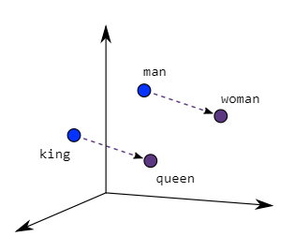

Why word embedding?
We need to somehow calculate the secret word – using the semantic distance
the host returns. Word embedding helps us to transform words & speeches
into vector representation while keeping knowledge about their context & semantics.
This way, we can use a trained semantic model as the area of knowledge for
our program – and to use it for calculations of ‘words’ as points in the space.
Why AI?
We want our program to gain information by guessing, process that information
And make better guesses until it finds the secret word.
Using various algorithms and the vector space of our semantic model we will improve our program guesses, by correcting their location in the vector space - until they will get to the exact location of the secret word!

Slide 8
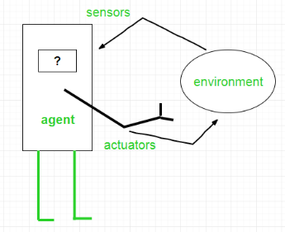
So, what’s our plan?
Strategy
Artificial intelligence is defined as the study of rational agents. A rational agent could be anything that makes decisions, as a person, firm, machine, or software. It carries out an action with the best outcome after considering past and current percepts(agent’s perceptual inputs at a given instance). An AI system is composed of an agent and its environment. The agents act in their environment. The environment may contain other agents.
Build an offline version of the game as research environment.
Establish communication with the ‘Semantle’ server.
Develop 3 different agents*, each with his unique state*, And
Provide them guessing algorithms (Naïve and one or more
Sophisticated algorithms).
Click for explanation
Running the agents and algorithms against the server, sample
Results (number of guesses, efficiency, speed, curve of guesses)
and produce conclusions and improvements.
Create a graphic user interface.
(read more at https://www.geeksforgeeks.org/agents-artificial-intelligence/)
Return
Document our research and pass hand it to the client.

Slide 9
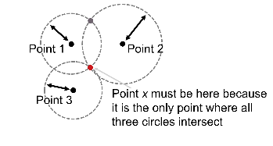



Our agents
We will create 3 different variants and for each of them we will formulate one trivial solution (random guessing) and at least one intelligent solution.
Trilateration is a type of measurement used to determine the location of a point by using the geometry of spheres, circles, or triangles. trilateration uses measures of distance and requires at least 3 points.
*trilateration is also used to determine location coordinates with Global Positioning System satellites and receivers.
The Host and the Agent have the exact same semantic model and the player does not know what the secret word the host is thinking about.
* This problem is a trilateration problem.
1
2
The Host and the Agent have different models, with possibly different number of dimensions, but both are semantic models. The distances that the host provides are the same distance as the player sees in his model.
3
The player does not hold a language model in his memory.
The Host provides him with one more query besides distance “Hint” such as k words closest to any word.
The trivial solution is pure heuristic search model - always go to the vertex that seems closest to the target and look at who are his friends.

Slide 10
Client
requirements

Slide 11

Functional requirements
The system will use pre-trained word models from external sources.
The system will provide the user an option to abort during runtime.
The system will allow the user to execute the game, simulating the ‘Semantle’ while in offline mode.
The system will support three different variants of the game, each with unique initial data.
The system will provide the user, for each “agent”, at least one naive guessing algorithm and one smart guessing algorithm.
The system shall create statistics output for each variant run (including number of guesses, running time, curve of guesses etc.), in csv files.
The system will support online connection and playing against the ‘Semantle’ game.
The system will only support word from the English vocabulary.
Each agent in the system will play against the game independently
The system will allow the user to choose between various semantic models.
The system will be able to supply hints for the agent about the secret word
(i.e as ‘k’ similar words to the secret word).

Slide 12
Non-functional requirements
Criteria | Implementation constraints
Performance | The model loading must take at most 10 minutes in 99% of the runs. The system must contain a disk memory size of at least 12GB. Sending and receiving data from the Semantle game should be as fast as possible.
Reliability & Stability | In case the ‘Semantle’ server crashes, the system will issue an appropriate error message to the user and offer an offline mode instead. The system must handle communications failure by holding a trained model which is in local memory. In case that user chooses an online mode, and the system fails to connect to the server, the system will not start the game. An offline host must be able to handle words that are not in the vocabulary it holds.
Portability | The system must keep a continuous connection with the ‘Semantle’ server while running the agents.
Usability | Users with basic knowledge of the ‘Semantle’ game, the word-embedding and AI fields should be able to use the system.
Availability | The system will be Available for the user to use if he has an internet connection or pre-downloaded the semantic models using the system.
platform | Running the system requires use in the ‘gensym’ library which uses words with the Word2Vec model. Both are open source and must run on version 3 of python. During a user game, the input and output of the system will be done using the command prompt.
Special restrictions | 1.In the offline game, The word selection will be chosen randomly from the model vocabulary. 2.The system vocabulary will include only words from the English vocabulary.

Slide 13
Road map
Establish connection to the server and develop our agents
Research of agents results, optimizations and conclusions documentation
Develop our agents’ algorithms and test it offline and online
Comfortable and elegant user interface for users
Offline version of Semantle for the development
STEP 3
FUTURE STATE
Semester B
STEP 2
Semester A
-current state-
STEP 1

Slide 14


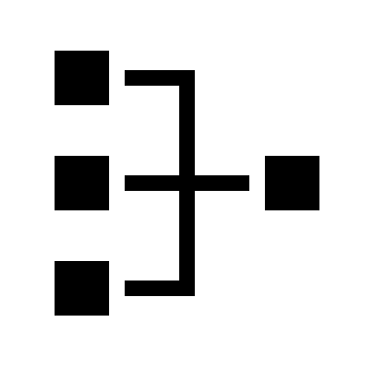


Technologies – API’S
‘Pygame’ API
https://www.pygame.org/docs/
Communication
‘requests’ library
https://pypi.org/project/requests/
Word embedding
‘Gensym’ library
https://radimrehurek.com/gensim/index.html
Algorithms
‘Numpy’, ‘scipy’, ‘tqdm’ libraries
‘Numpy’, ‘panda’ libraries
Design
Statistics

Slide 15
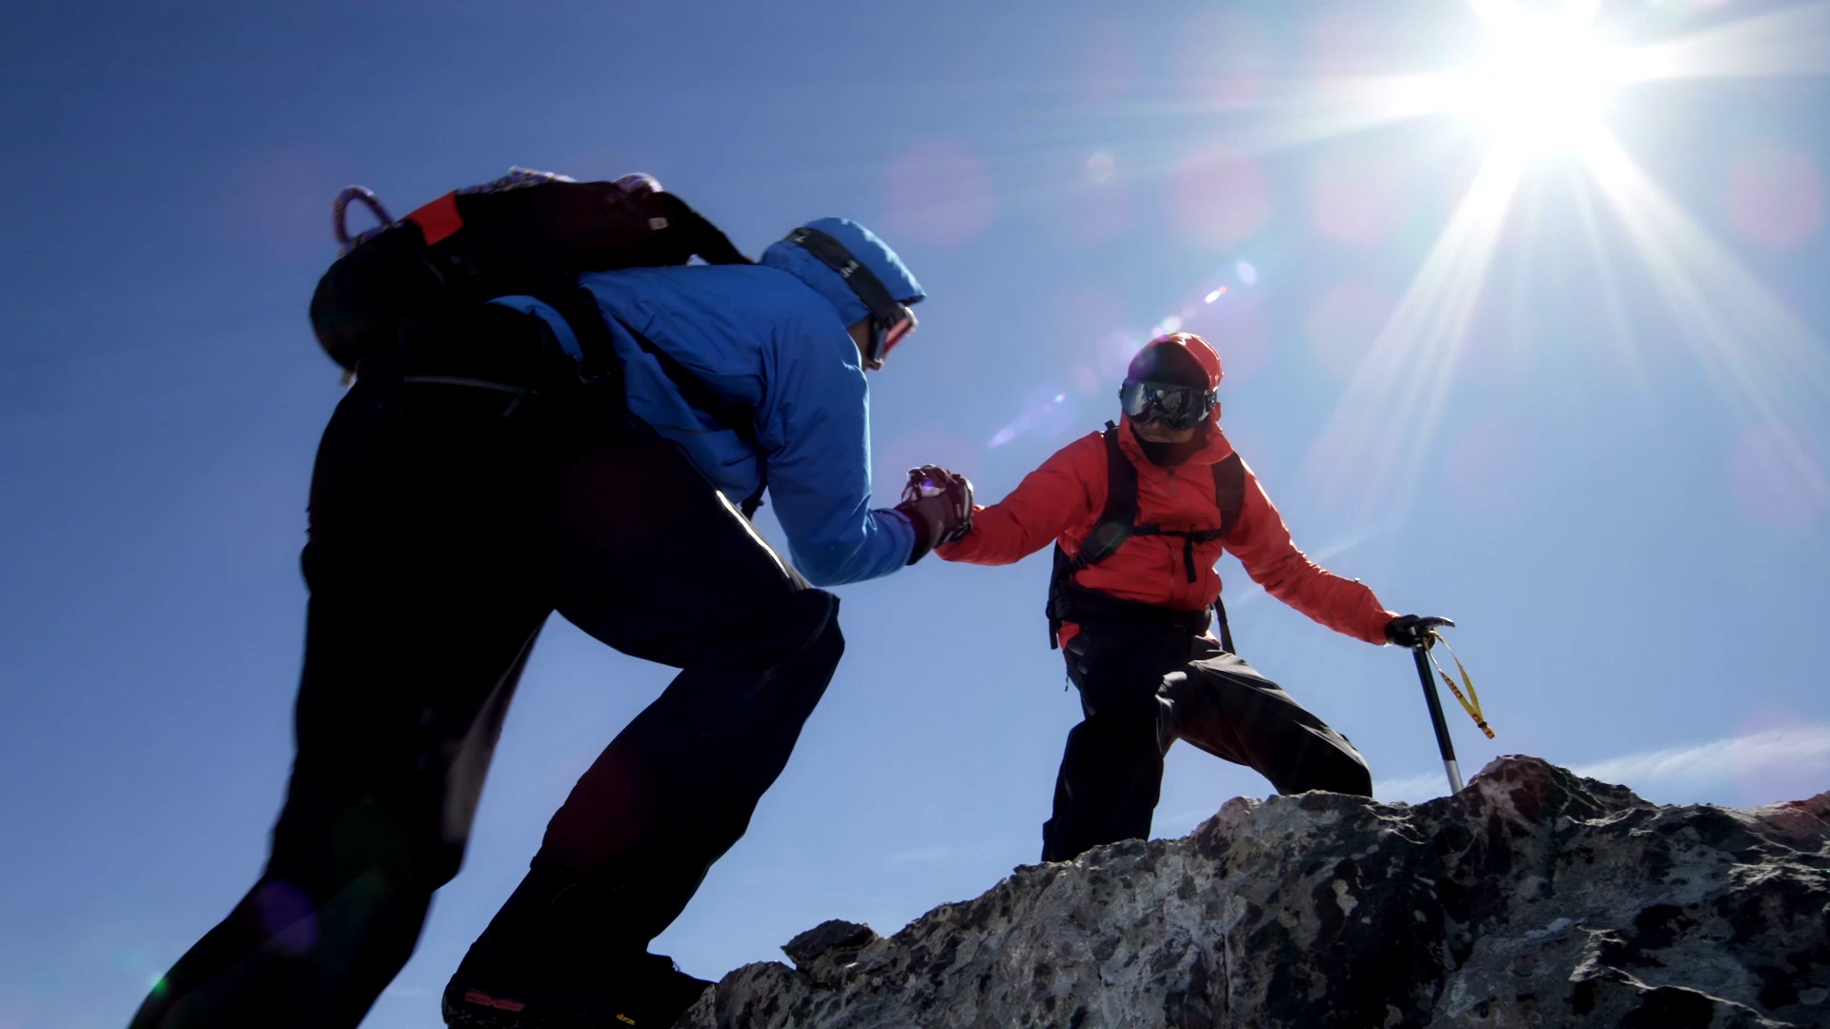

Challenges
Issue -
Lack of experience with AI, Word embedding, nor academic research field.
Solution -
Google it!
Mentors' guidance

Slide 16
THANK YOU
Questions?

